Slide 1
Renkarnasi
Abdul Aziz Fahkrul S
Tony Wijaya

Slide 2
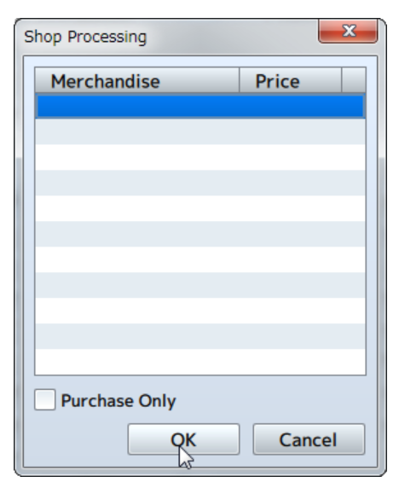
Shop Processing
Calls the shop screen where the player can buy weapons, armors and items.

Slide 3
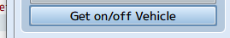
Get on/off Vehicle
Controls getting on and off vehicles. The player will get off onto the ground when on the vehicle, and get on the vehicle when not on it. There are no parameters to set.

Slide 4
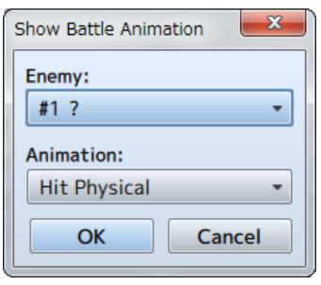
Show Battle Animation
Displays an animation using the enemy as the target.

Slide 5
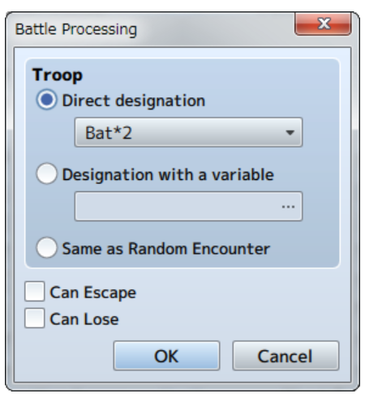
Battle Processing
If you want to modify this graph, click on it, follow the link, change the data and replace it

Slide 6
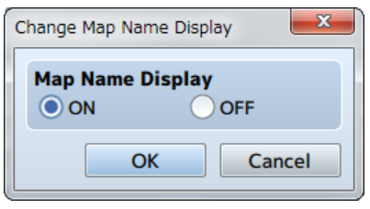
Change Map Name Display
Controls whether or not the name of a map will be displayed when moving to a different map.

Slide 7
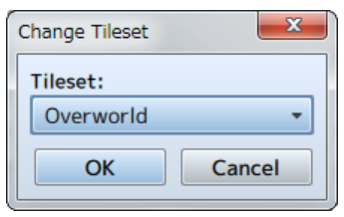
Change Tileset
Changes the settings of the map's tileset. The tileset that can be changed is limited to the map where the event was placed.

Slide 8
Thank You

Slide 9
Sekilas Tentang Game
test

Slide 10
Quest 1
QUEST 2
QUEST
Menemukan Rekan di Dalam Guild
Mengumpulkan item didalam hutan
01
02

Slide 11
Comic Style Infographics
Saturn is composed of hydrogen and helium
Despite being red, Mars is a cold place
Mercury is the closest object to the Sun
Jupiter is a gas giant and the biggest planet
Neptune is the farthest planet from the Sun

Slide 12
Comic Style Infographics
01
02
03
04
05
Earth
Neptune
Saturn
Mars
Mercury
Earth is the third planet from the Sun
Neptune is the farthest planet from the Sun
It’s composed of hydrogen and helium
Despite being red, Mars is a cold place
Mercury is the closest object to the Sun

Slide 13
Comic Style Infographics
Earth
20%
Earth is the third planet from the Sun
Neptune
50%
Neptune is the farthest planet from the Sun
Saturn
90%
Saturn is composed of hydrogen and helium

Slide 14
Comic Style Infographics
Earth
Neptune
Saturn
Mars
Mercury
Earth is the third planet from the Sun
Neptune is the farthest planet from the Sun
It’s composed of hydrogen and helium
Despite being red, Mars is a cold place
Mercury is the closest object to the Sun

Slide 15
Comic Style Infographics
Earth
Mercury
01
Earth is the third planet from the Sun
Mercury is the closest object to the Sun
04
Neptune
Mars
02
Neptune is the farthest planet from the Sun
Despite being red, Mars is a cold place
05
Saturn
Jupiter
03
Saturn is composed of hydrogen and helium
Jupiter is a gas giant and the biggest planet
06

Slide 16
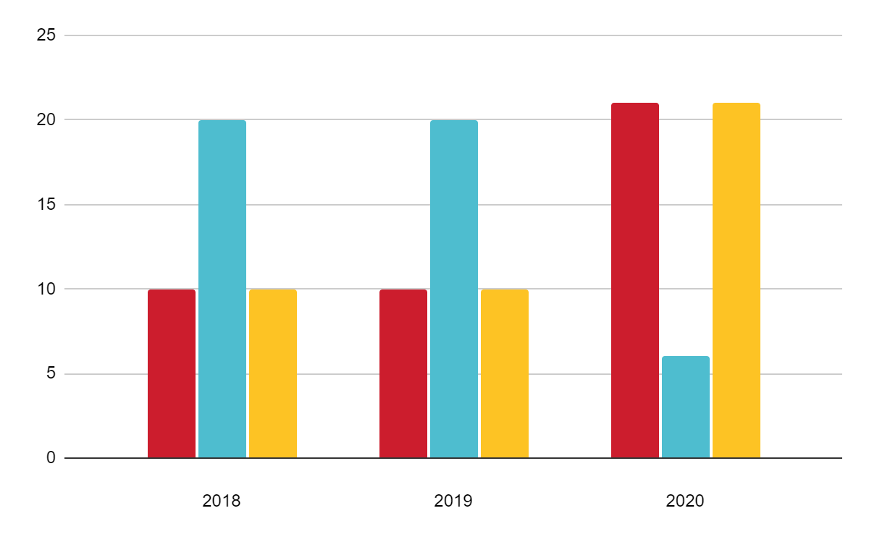
Comic Style Infographics
25k
Earth
Earth is the third planet from the Sun
46k
Neptune
Neptune is the farthest planet from the Sun
84k
Mercury
If you want to modify this graph, click on it, follow the link, change the data and replace it
Mercury is the closest object to the Sun

Slide 17
Comic Style Infographics
Mars
Saturn
Mercury
Despite being red, Mars is actually a very cold place
Saturn is a gas giant and has several rings
Mercury is the closest object to the Sun
Neptune
Venus
Neptune is the farthest planet from the Sun
Venus is the second planet from the Sun

Slide 18
Comic Style Infographics
Earth
01
Earth is the third planet from the Sun
45K
Neptune
02
Neptune is the farthest planet from the Sun
85K
Mercury
03
Mercury is the closest object to the Sun
26K

Slide 19
Comic Style Infographics
TIME | SUN | MON | TUE | WED | THU | FRI | SAT
9:00 | Gym | Gym | Yoga | Gym | Yoga | Yoga | Dancing
10:00 | Read | Study | Study | Study | Walk | Class | Study
11:00 | Study | Doodling | Class | Study | Project | Project | Study
12:00 | Project | Study | Cinema | Exam | Study | Meditate | Brunch
13:00 | Music | Coffee | Study | Museum | Study | Project | Trip
14:00 | Lunch | Lunch | Lunch | Lunch | Lunch | Lunch | Trip

Slide 20
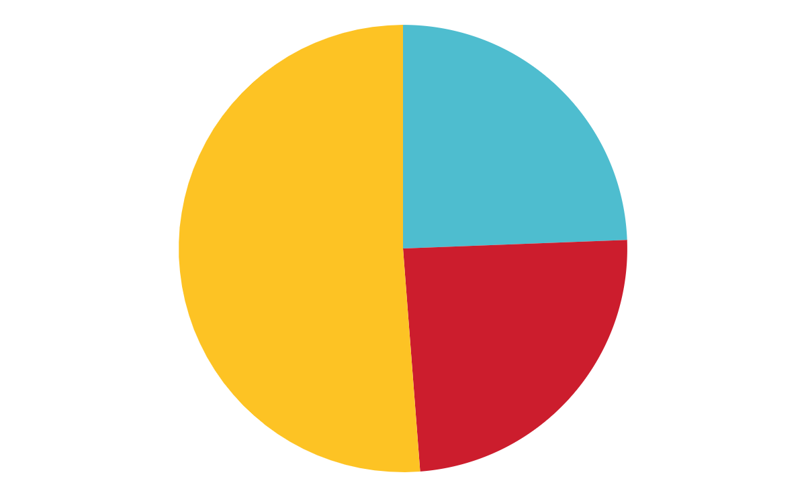
Comic Style Infographics
Mercury
It’s the closest object to the Sun
20K
Mars
Despite being red, Mars is a cold place
55K
Jupiter
Jupiter is a gas giant and the biggest planet
25K
If you want to modify this graph, click on it, follow the link, change the data and replace it

Slide 21
Comic Style Infographics
Saturn
Saturn is composed of hydrogen and helium
Earth
Earth is the third planet from the Sun
Neptune
Neptune is the farthest planet from the Sun

Slide 22
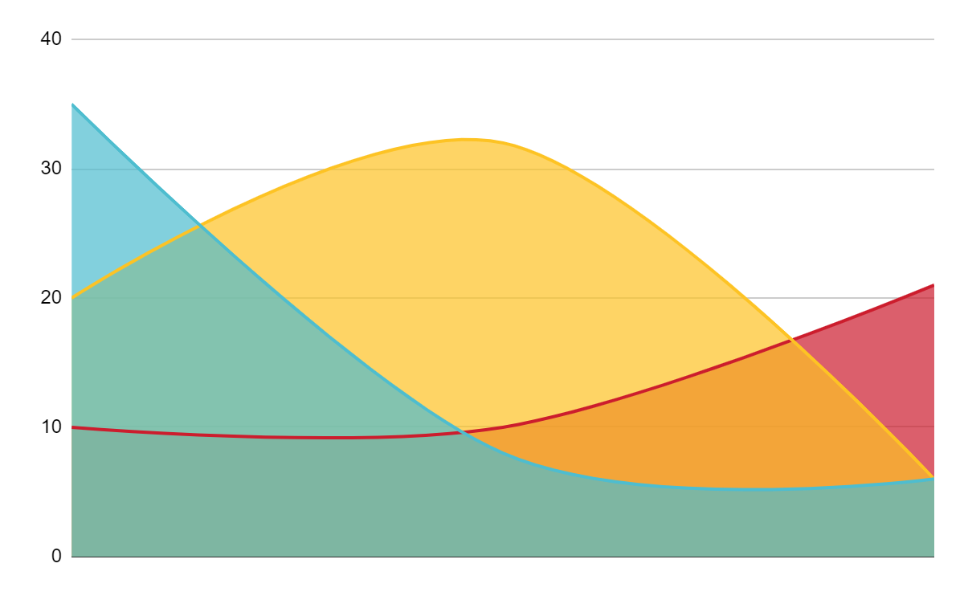
Comic Style Infographics
Earth
20%
Earth is the third planet from the Sun
Neptune
50%
Neptune is the farthest planet from the Sun
Saturn
90%
Saturn is composed of hydrogen and helium
If you want to modify this graph, click on it, follow the link, change the data and replace it

Slide 23
Comic Style Infographics
It is composed of hydrogen and helium
Jupiter is a gas giant and the biggest object
Planet Mars is a very cold place
45%
75%
60%
Saturn
Jupiter
Mars

Slide 24
Comic Style Infographics
01
Earth
Earth is the third planet from the Sun
02
Neptune
It’s the farthest planet from the Sun
03
Saturn
It’s composed of hydrogen and helium

Slide 25
Comic Style Infographics
82K
45K
Saturn
Mars
It’s composed of hydrogen and helium
Despite being red, Mars is a cold place

Slide 26
Comic Style Infographics
Mercury
It’s the first planet in our Solar System
90%
Mars
Despite being red, Mars is a cold place
40%
Jupiter
Jupiter is a gas giant and the biggest planet
60%

Slide 27
Comic Style Infographics
Jupiter
84k
Jupiter is a gas giant and the biggest planet
Earth
67k
Earth is the third planet from the Sun
Neptune
46k
Neptune is the farthest planet from the Sun
Saturn
27k
Saturn is composed of hydrogen and helium

Slide 28
Comic Style Infographics
Jupiter
Neptune
97K
Jupiter is a gas giant and the biggest planet
It’s the farthest planet from the Sun
74K
62K
Earth
Saturn
Earth is the third planet from the Sun
34K
It’s composed of hydrogen and helium

Slide 29
Comic Style Infographics
Earth
Mercury
01
Earth is the third planet from the Sun
Mercury is the closest object to the Sun
04
Neptune
Mars
02
Neptune is the farthest planet from the Sun
Despite being red, Mars is a cold place
03

Slide 30
Comic Style Infographics
01
02
03
04
Earth
Neptune
Saturn
Mars
Earth is the third planet from the Sun
Neptune is the farthest planet from the Sun
It’s composed of hydrogen and helium
Despite being red, Mars is a cold place

Slide 31
Comic Style Infographics
45K
65K
86K
Earth
Neptune
Saturn
Earth is the third planet from the Sun
Neptune is the farthest planet from the Sun
It’s composed of hydrogen and helium

Slide 32
Comic Style Infographics
Mars
Saturn
Mars is incredibly a very cold place
It is composed of hydrogen and helium
Jupiter
Mercury
the biggest object in the Solar System
It’s the closest planet to the Sun

Slide 33
Comic Style Infographics
01
02
Earth
Mercury
Earth is the third planet from the Sun
Mercury is the closest object to the Sun
03
04
Neptune
Mars
Neptune is the farthest planet from the Sun
Despite being red, Mars is a cold place

Slide 34
Comic Style Infographics
Mercury
Mercury is the closest object to the Sun
Mars
Despite being red, Mars is a cold place

Slide 35
Comic Style Infographics
Mars
10k
Saturn
8k
Despite being red, Planet Mars is a very cold place
It is the ringed planet. It is composed of hydrogen and helium
Jupiter
6k
Mercury
4k
It’s a gas giant and the biggest object in the Solar System
Mercury is the closest planet to the Sun and the smallest one

Slide 36
Comic Style Infographics
25K
15K
Neptune
Neptune is the farthest planet from the Sun
Earth
Earth is the third planet from the Sun

Slide 37
Comic Style Infographics
01
Jupiter
Jupiter is a gas giant and the biggest planet
02
Earth
Earth is the third planet from the Sun

Slide 38
Comic Style Infographics
01
Earth
Earth is the third planet from the Sun
02
Neptune
Neptune is the farthest planet from the Sun
03
Saturn
It’s composed of hydrogen and helium

Slide 39
Comic Style Infographics
Earth
Neptune
Saturn
Mars
Earth is the third planet from the Sun
Neptune is the farthest planet from the Sun
It’s composed of hydrogen and helium
Despite being red, Mars is a cold place

Slide 40
Instructions for use
In order to use this template, you must credit Slidesgo and Freepik in your final presentation and include links to both websites.
You are allowed to:
- Modify this template.
- Use it for both personal and commercial projects.
You are not allowed to:
- Sublicense, sell or rent any of Slidesgo Content (or a modified version of Slidesgo Content).
- Distribute Slidesgo Content unless it has been expressly authorized by Slidesgo.
- Include Slidesgo Content in an online or offline database or file.
- Offer Slidesgo templates (or modified versions of Slidesgo templates) for download.
- Acquire the copyright of Slidesgo Content.
For more information about editing slides, please read our FAQs or visit Slidesgo School:
https://slidesgo.com/faqs and https://slidesgo.com/slidesgo-school

Slide 41
Infographics
You can add and edit some infographics to your presentation to present your data in a visual way.
Choose your favourite infographic and insert it in your presentation using Ctrl C + Ctrl V or Cmd C + Cmd V in Mac.
Select one of the parts and ungroup it by right-clicking and choosing “Ungroup”.
Change the color by clicking on the paint bucket.
Then resize the element by clicking and dragging one of the square-shaped points of its bounding box (the cursor should look like a double-headed arrow). Remember to hold Shift while dragging to keep the proportions.
Group the elements again by selecting them, right-clicking and choosing “Group”.
Repeat the steps above with the other parts and when you’re done editing, copy the end result and paste it into your presentation.
Remember to choose the “Keep source formatting” option so that it keeps the design. For more info, please visit Slidesgo School.

